Slide 1
Info security concepts materialized
Joseph zeng
Div0 Meetup – 15 January 2019

Slide 2
whoami
Twitter: @josephzengSG
2004 – 2006: Regimental Policeman, Republic of Singapore Air Force
2010 – 2012: Software development for military
2012 – 2017: Security Testing for many companies
2017- Present: Security Testing for Lazada.

Slide 3


Slide 4
Agenda
Identifying Requirements
Minimizing Attack Surface
Threat Modeling: Generating Mis-use cases

Slide 5
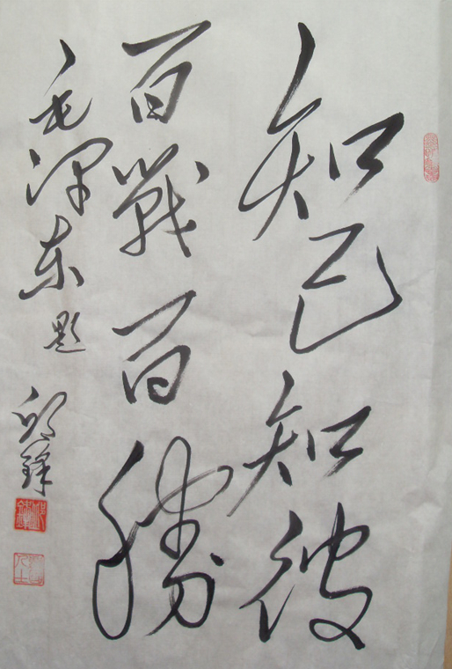
“If you know the enemy and know yourself, you need not fear the result of a hundred battles. If you know yourself but not the enemy, for every victory gained you will also suffer a defeat. If you know neither the enemy nor yourself, you will succumb in every battle.”
Sun Tzu, The Art of War

Slide 6
How strong?

Slide 7
Minimising Attack Surface
Computers on the Network – unused applications, default data, ports
Physical areas – Unused doors, keys, passes.

Slide 8
Generating Misuse Cases
“A misuse case is the inverse of a use case, i.e., a function that the system should not allow. Just as defines a use case as a completed sequence of actions which gives increased value to the user, one could define a misuse case as a completed sequence of actions which results in loss for the organization or some specific stakeholder.”
- Guttorm Sindre & Andreas L. Opdahl (2001)

Slide 9
Generating Misuse Cases
Threat Modeling
Web App
Physical
Spoofing
Tampering
Repudiation
Information Disclosure
Denial of Service
Elevation of privilege
Broken Auth
Injection, XSS
Insufficient Logging & Monitoring
Sensitive Data Exposure
Security Misconfiguration
Missing Function Level Access Control
OWASP Top 10 2013, 2017
Mis-representation, Fraud (8.6)
Controls Verification – Integrity (8.7.4)
Controls Verification – Non-repudiation (8.7.1)
Exposure Verification (8.12)
Survivability Validation – Continuity (8.16.2)
Privileges Audit (8.15)
OSSTMM 3

Slide 11
References & Links
Threat Modeling Again, STRIDE https://blogs.msdn.microsoft.com/larryosterman/2007/09/04/threat-modeling-again-stride/
Protecting Your System: Physical Security, National Center for Education Statistics https://nces.ed.gov/pubs98/safetech/chapter5.asp
Trespassing - entering into or remaining in a house, worship building or any owned property https://sso.agc.gov.sg/Act/PC1871#pr442-
KringleCon - Rachel Tobac, How I would Hack You: Social Engineering Step-by-Step https://www.youtube.com/watch?v=L5J2PgGOLtE
Capturing Security Requirements through Misuse Cases, Guttorm Sindre & Andreas L. Opdahl https://folk.uio.no/nik/2001/21-sindre.pdf
Cyber Security Response to Physical Security breaches https://www.us-cert.gov/sites/default/files/publications/css_cyberresponse0712.pdf
COUNTERING THE THREAT OF PHYSICAL SECURITY BREACHES http://www.datacenterjournal.com/countering-threat-physical-security-breaches/
Chapter 8 - Physical Security Testing, OSSTMM http://www.isecom.org/mirror/OSSTMM.3.pdf
Why cybercriminals are stalking your social media accounts https://www.channelnewsasia.com/news/cnainsider/why-cyber-criminals-are-stalking-social-media-accounts-free-wifi-11100764

